Slide 1
SOEN 6611 SOFTWARE MEASUREMENT
Submitted to: Jinqiu Yang
Submitted by:
40084709 : Suruthi Raju
40129435 : Pranoti Mulay
40078258 : Avinash Damodaran
40088004 : Shalin Patel
40080612 : Niralkumar Lad
GROUP J

Slide 2
Outline
Repositories Used
Metric 1 , Metric 2 and Metric 4: Statement Coverage, Branch Coverage and McCabe Cyclomatic complexity
Metric 3: Mutation Score
Metric 5 and Metric 6: Maintenance Effort Estimation Model and Software Defect Density
Correlations:
Metric 1 and 2 Vs Metric 3
Metric 1 and 2 Vs Metric 4
Metric 1 and 2 Vs Metric 6
Metric 5 Vs Metric 6

Slide 3
Repositories Used
Number | Repository | Version | Lines of Code
1 | Apache Commons Logging | 1.2 | 18K
2 | Apache Commons Math | 3.6.1 | 387K
3 | Apache commons Lang | 3.10 | 154K
4 | Apache Commons Net | 3.6 | 62K

Slide 4
Metric 1: Statement Coverage Metric 2: Branch Coverage Metric 4: McCabe Cyclomatic complexity

Slide 5
Tool, Process and Challenges
Tool: JaCoCo
Why JaCoCo?
Easy integration with eclipse and free as well as Open-Source for Java.
Process:
Imported projects in eclipse.
Resolved dependencies error.
Ran the tool i.e. JaCoCo to calculate metric 1,2 and 4.
Challenges:
Resolving dependencies error.
Ignoring some test cases that were not detecting any coverage.

Slide 6
Results:
Number | Repository | Metric 1: Statement Coverage | Metric 2: Branch Coverage | Metric 4: McCabe Cyclomatic Complexity
1 | Apache Commons Logging | 0.51 | 0.3844 | 51.55%
2 | Apache Commons Math | 0.919 | 0.843 | 81.73%
3 | Apache commons Lang | 0.943 | 0.8728 | 81.34%
4 | Apache Commons Net | 0.543 | 0.3278 | 33.97%

Slide 7
Metric 3: Mutation Score

Slide 8
Tool, Process and Challenges
Tool: PitClipse
Process:
Install PitClipse and add plugin to POM.xml
Resolve the dependencies if any exists
Open terminal and write the following command:
mvn org.pitest:pitest-maven:mutationCoverage
Challenges:
Multiple time outs
Ignoring some test cases that were not detecting any mutation.

Slide 9
Results
Number | Repository | Metric 3 Mutation Score
1 | Apache Commons Logging | 23%
2 | Apache Commons Math | 79%
3 | Apache commons Lang | 85%
4 | Apache Commons Net | 24%

Slide 10
Metric 5: Maintenance Effort Estimation Model Metric 6: Software Defect Density

Slide 11
Tool and Process
Tool: CLOC
Process:
Installing CLOC
Open terminal and write for the following line with the folder path
Metric 5
cloc –diff folderPath1 folderPath2
Metric 6
Cloc folderPath

Slide 12
Results Apache Commons Logging
Version | Metric 5 |  | Metric 6
 | DLOC | Effort Required (person hours) | LOC | No. of bugs | Software Defect Density
1.0.4 | 993 | 87.93 | 9564 | 23 | 2.404851527
1.1 | 4157 | 119.57 | 16604 | 9 | 0.542038063
1.1.1 | 568 | 83.68 | 18898 | 14 | 0.740819134
1.1.2 | 5806 | 136.06 | 18155 | 2 | 0.11016249
1.1.3 | 0 | 78 | 18150 | 0 | 0
1.2 | 83 | 78.83 | 18257 | 2 | 0.109547023

Slide 13
Results(Continue) Apache Commons Math
Version | Metric 5 |  | Metric 6
 | DLOC | Effort Required (person hours) | LOC | No. of bugs | Software Defect Density
1.0 | 15873 | 236.73 | 36846 | 13 | 0.3528198
1.1 | 4696 | 124.96 | 47871 | 24 | 0.5013474
2.0 | 85787 | 935.87 | 156848 | 66 | 0.4207896
2.1 | 13768 | 215.68 | 165423 | 51 | 0.3083005
2.2 | 21411 | 292.11 | 193422 | 68 | 0.3515629
3.4 | 135802 | 1436.02 | 362017 | 12 | 0.0331476
3.6.1 | 18473 | 262.73 | 387777 | 37 | 0.0954157

Slide 14
Results(Continue) Apache Commons Lang
Version | Metric 5 |  | Metric 6
 | DLOC | Effort Required (person hours) | LOC | No. of bugs | Software Defect Density
2.6 | 3046 | 108.46 | 107100 | 20 | 0.1867414
3.2 | 60259 | 680.59 | 121483 | 34 | 0.2798746
3.3 | 2687 | 104.87 | 125454 | 6 | 0.0478263
3.4 | 4368 | 121.68 | 129956 | 59 | 0.4539998
3.5 | 10982 | 187.82 | 141758 | 35 | 0.2468996
3.10 | 36569 | 443.69 | 154791 | 2 | 0.0129206

Slide 15
Results(Continue) Apache Commons Net
Version | Metric 5 |  | Metric 6
 | DLOC | Effort Required (person hours) | LOC | No. of bugs | Software Defect Density
1.4.1 | 12 | 78.12 | 39741 | 84 | 2.1136861
2.2 | 17591 | 253.91 | 46940 | 29 | 0.61781
3.3 | 8017 | 158.17 | 57513 | 44 | 0.7650444
3.4 | 3563 | 113.63 | 61848 | 11 | 0.1778554
3.5 | 231 | 80.31 | 62066 | 14 | 0.2255663
3.6 | 1152 | 89.52 | 62865 | 27 | 0.4294918

Slide 16
Correlation

Slide 17
Metric 4 vs Metric 1

Slide 18
Metric 4 vs Metric 2

Slide 19
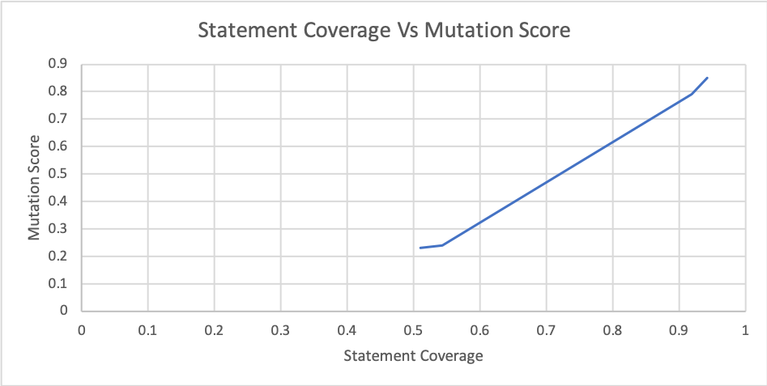
Metric 3 vs Metric 1

Slide 20
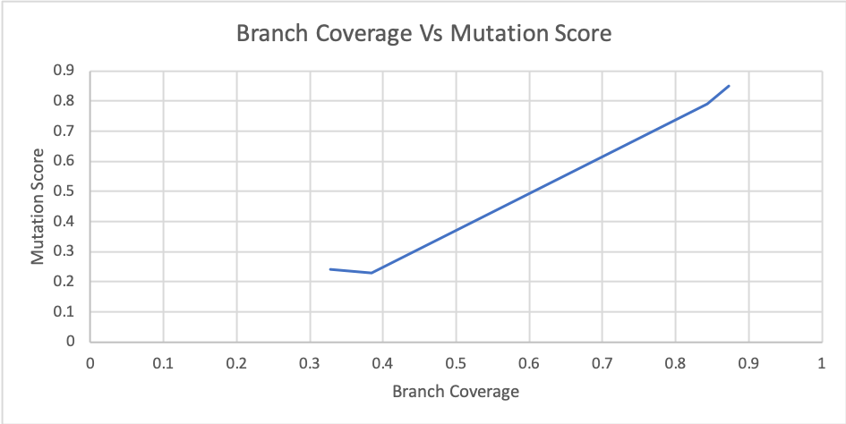
Metric 3 vs Metric 2

Slide 21
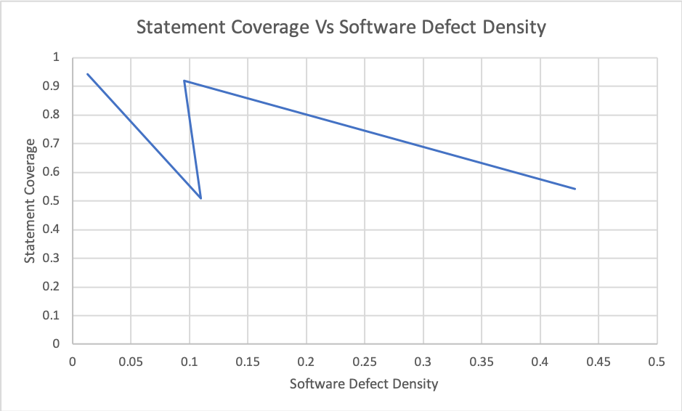
Metric 1 vs Metric 6

Slide 22
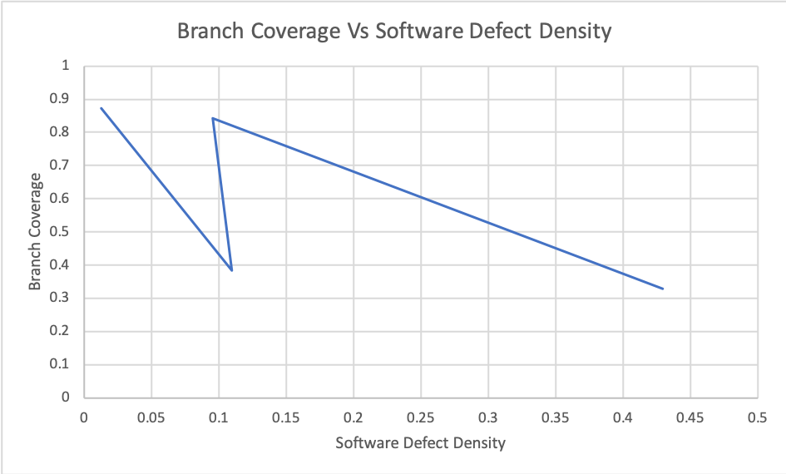
Metric 2 vs Metric 6

Slide 23
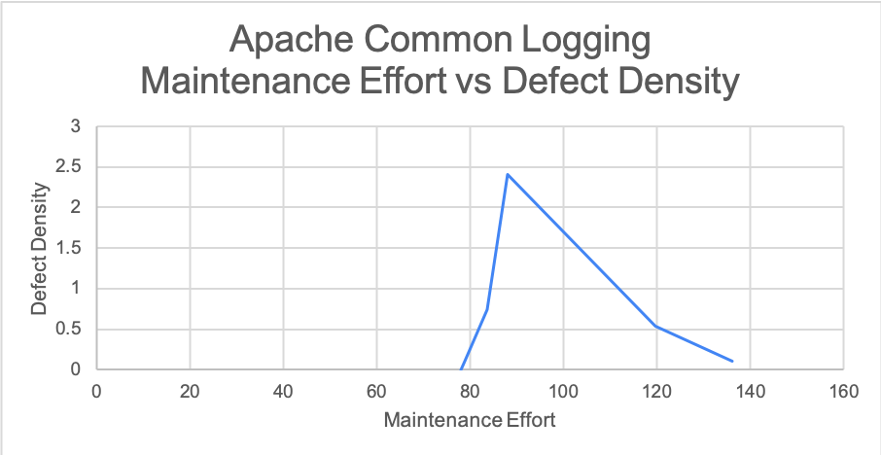
Metric 5 vs Metric 6 Apache Commons Logging

Slide 24
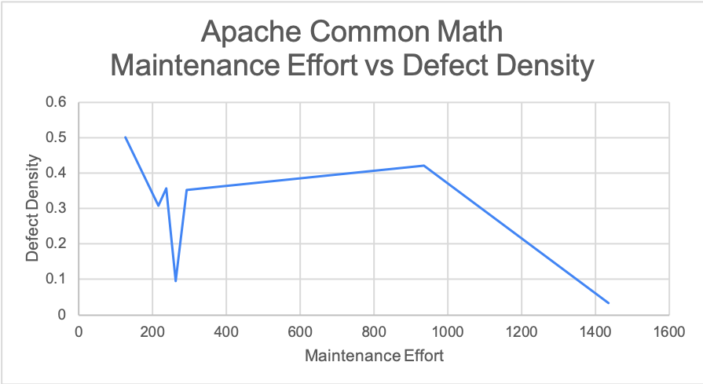
Metric 5 vs Metric 6(Continue) Apache Commons Math

Slide 25
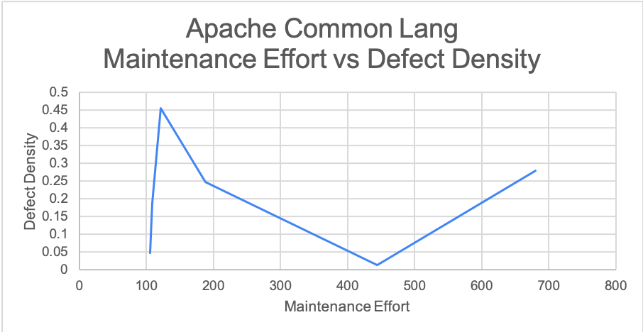
Metric 5 vs Metric 6(Continue) Apache Commons Lang

Slide 26
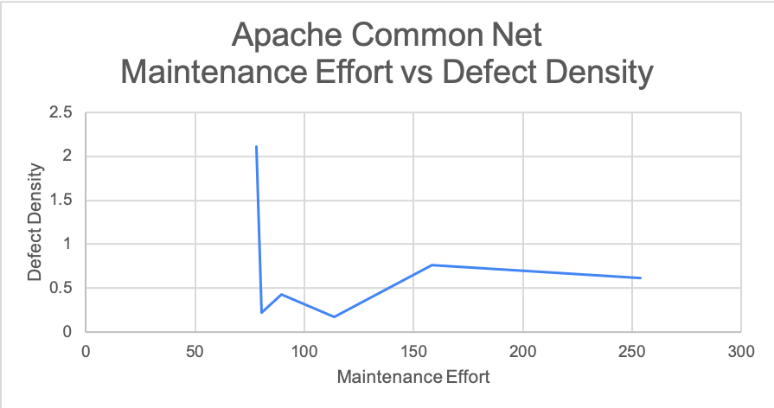
Metric 5 vs Metric 6(Continue) Apache Commons Net

Slide 27
References
Cyclomatic complexity [Online]. Available: https://en.wikipedia.org/wiki/Cyclomatic_complexity [Accessed: 15-Feb-2020].
Mccabe's Cyclomatic Complexity: Calculate with Flow Graph (Example) [Online]. Available: https://www.guru99.com/cyclomatic-complexity.html [Accessed: 15-Feb-2020].
M. M. S. Sarwar, S. Shahzad and I. Ahmad, "Cyclomatic complexity: The nesting problem," IEEE, 2014.
Mutation Testing in Software Testing: Mutant Score & Analysis Example [Online]. Available: https://www.guru99.com/mutation-testing.html [Accessed: 15-Feb-2020].
ThinkSys, “34 Software Testing Metrics & KPIs: Complete Guide,” ThinkSys Inc, 11-Oct-2019. [Online]. Available: https://www.thinksys.com/qa-testing/software-testing-metrics-kpis/. [Accessed: 16-Feb-2020].
J. Arnold, “64 Essential Software Quality Testing Metrics For Measuring Success,” QASymphony, 07-Jan-2019. [Online]. Available: https://www.qasymphony.com/blog/64-test-metrics/. [Accessed: 16-Feb-2020].

